Slide 1

Unit 5

Slide 2
Regional Market Segments
Reasons for regional marketing
  Need for more focused targeting
  The shift from national advertising to sales promotions
Drawbacks
  Production headaches
  Marketing efficiency may suffer and costs may rise

Slide 3
Rationale for Going International
Perception of slow growth and increased competition in domestic markets
Belief in enhanced overseas growth and profit opportunities
Desire to reduce costs from economies of scale
Need to diversify risk
Recognition of global mobility of customers

Slide 4

Standardization vs. Customization
According to Levitt, because the world is shrinking —due to leaps in technology, communication, and so forth—well-managed companies should shift their emphasis from customizing items to offering globally standardized products that are advanced, functional, reliable, and low priced for all.

Slide 5
Standardization vs. Customization
Blending global objectives with local or regional concerns
“Think global. Act local.”
A global brand has a clear consistent equity across geographies: same positioning, same benefits plus local tailoring if needed

Slide 6
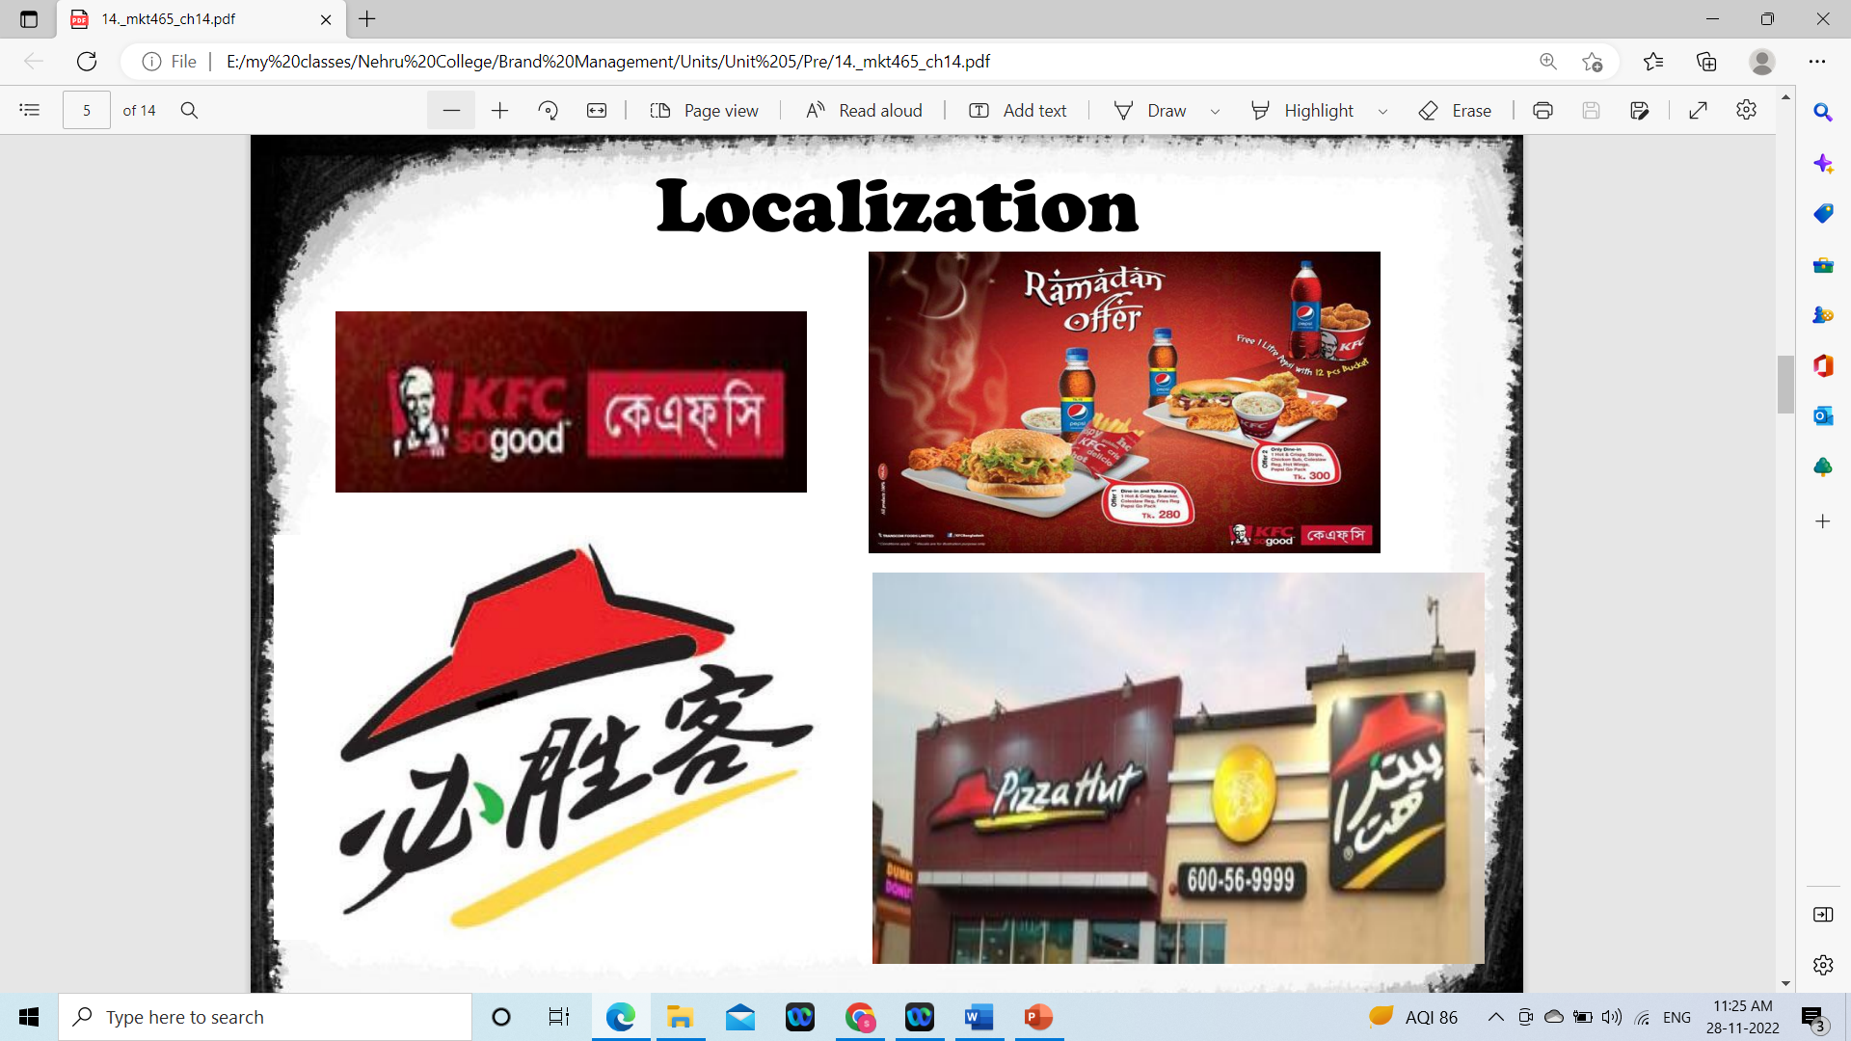

Slide 7
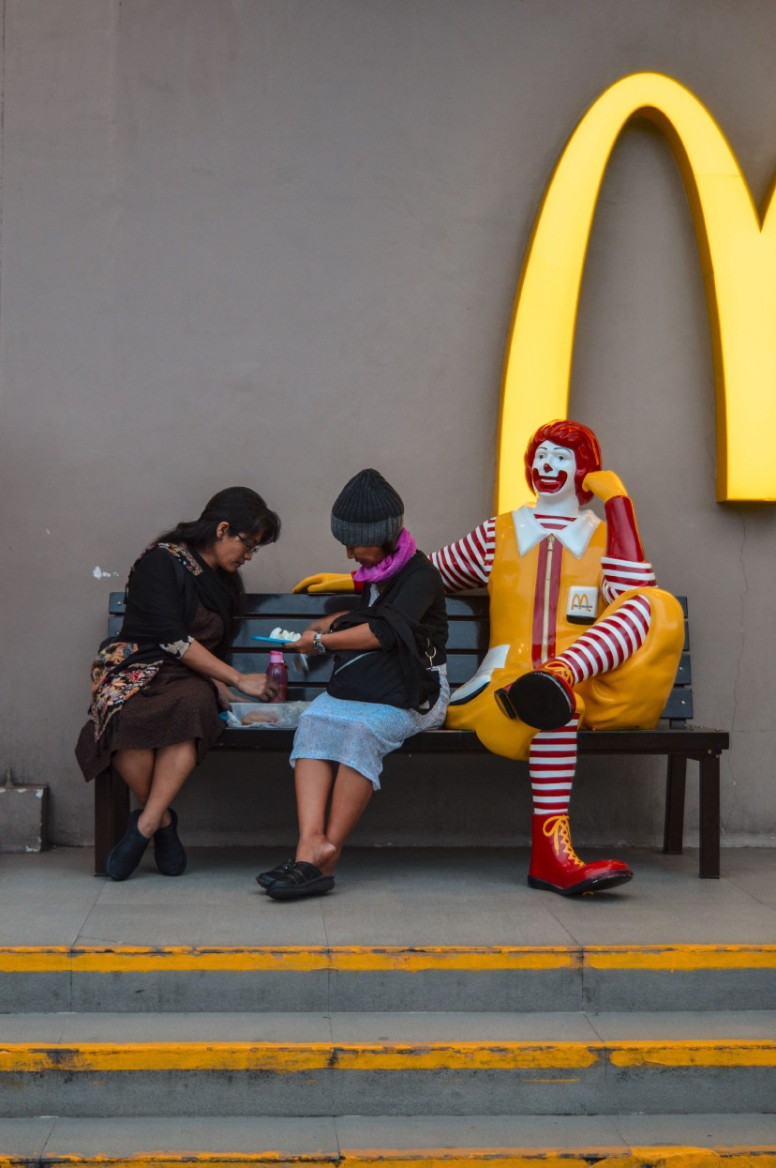
McDonald’s Failed in Vietnam

Slide 8
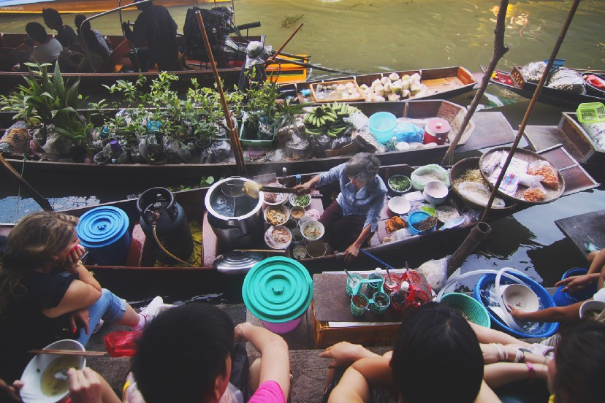
The Local Competition Was Tough

Slide 9
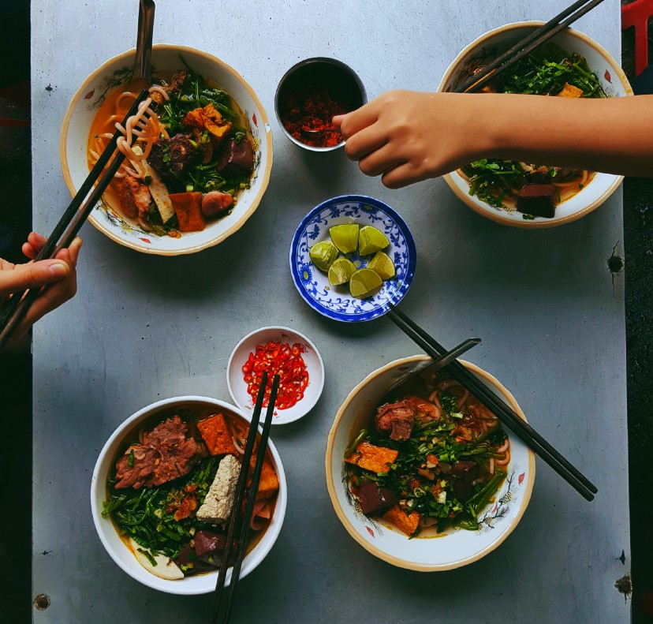
‘Sit Back, Relax, and Share Your Food’ Culture of Vietnam.

Slide 10

Advantages of Global Marketing Programs
Economies of scale in production and distribution
Lower marketing costs
Higher power and wider scope
Consistency in brand image
Leverage good ideas quickly and efficiently
Uniformity of marketing practices

Slide 11

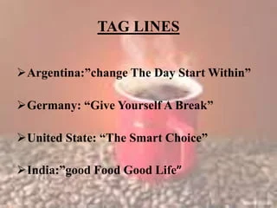


Slide 12

Disadvantages of Global Marketing Programs
Differences in consumer needs, wants, and usage patterns for products
Differences in brand and product development and the competitive environment
Differences in the legal environment
Differences in marketing institutions
Differences in administrative procedures

Slide 13

Developed Vs. Developing Countries
The bottom of pyramid is a booming market
Brand symbols are important for this market
Packaging – Sachets
Promotion – Use specific channels
Distribution – Urban vs. Rural

Slide 14


Slide 15
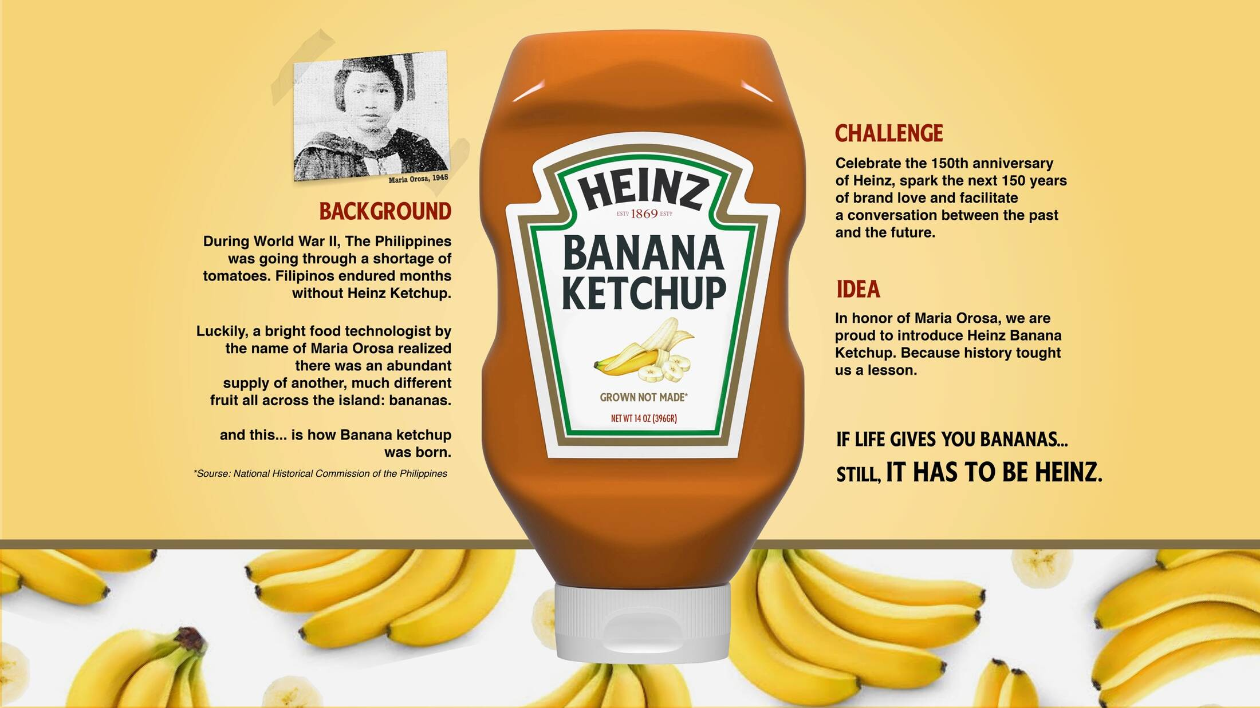

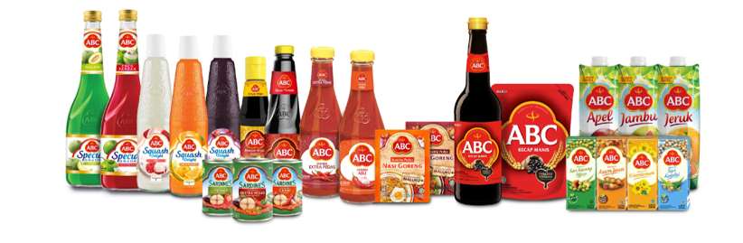


Slide 16
Ten Commandments of Global Branding
Understand similarities and differences in the global branding landscape
Don’t take shortcuts in brand building
Establish marketing infrastructure
Embrace integrated marketing communications
Cultivate brand partnerships
Balance standardization and customization
Balance global and local control
Define operable guidelines
Implement a global brand equity measurement system
Leverage brand elements

Slide 17

Different Types of Brand
Personal Brand
Product Brand
Service Brand
Corporate Brand
Investor Brand
Non-Profit Brands or NGO Brand
Public Brand
Activist Brand
Place Brand
Nation Brand

Slide 18
Different Types of Brand
Ethical Brand
Celebrity Brand
Ingredient Brand
Global Brand
Challenger Brand
Generic Brand
Luxury Brand
Cult Brand
Clean Slate Brand
Private Brand
Employer Brand

